Slide 1
Android Unlock Pattern Security
Team 4
Presentation template

Slide 2
Team members:
Tong Wu (tw445)
Xun Tang (xt63)
XInyu Lyu (xl422)
You can contact us at
tw445@scarletmail.rutgers.edu
xt63@scarletmail.rutgers.edu
xl422@scarletmail.rutgers.edu

Slide 3

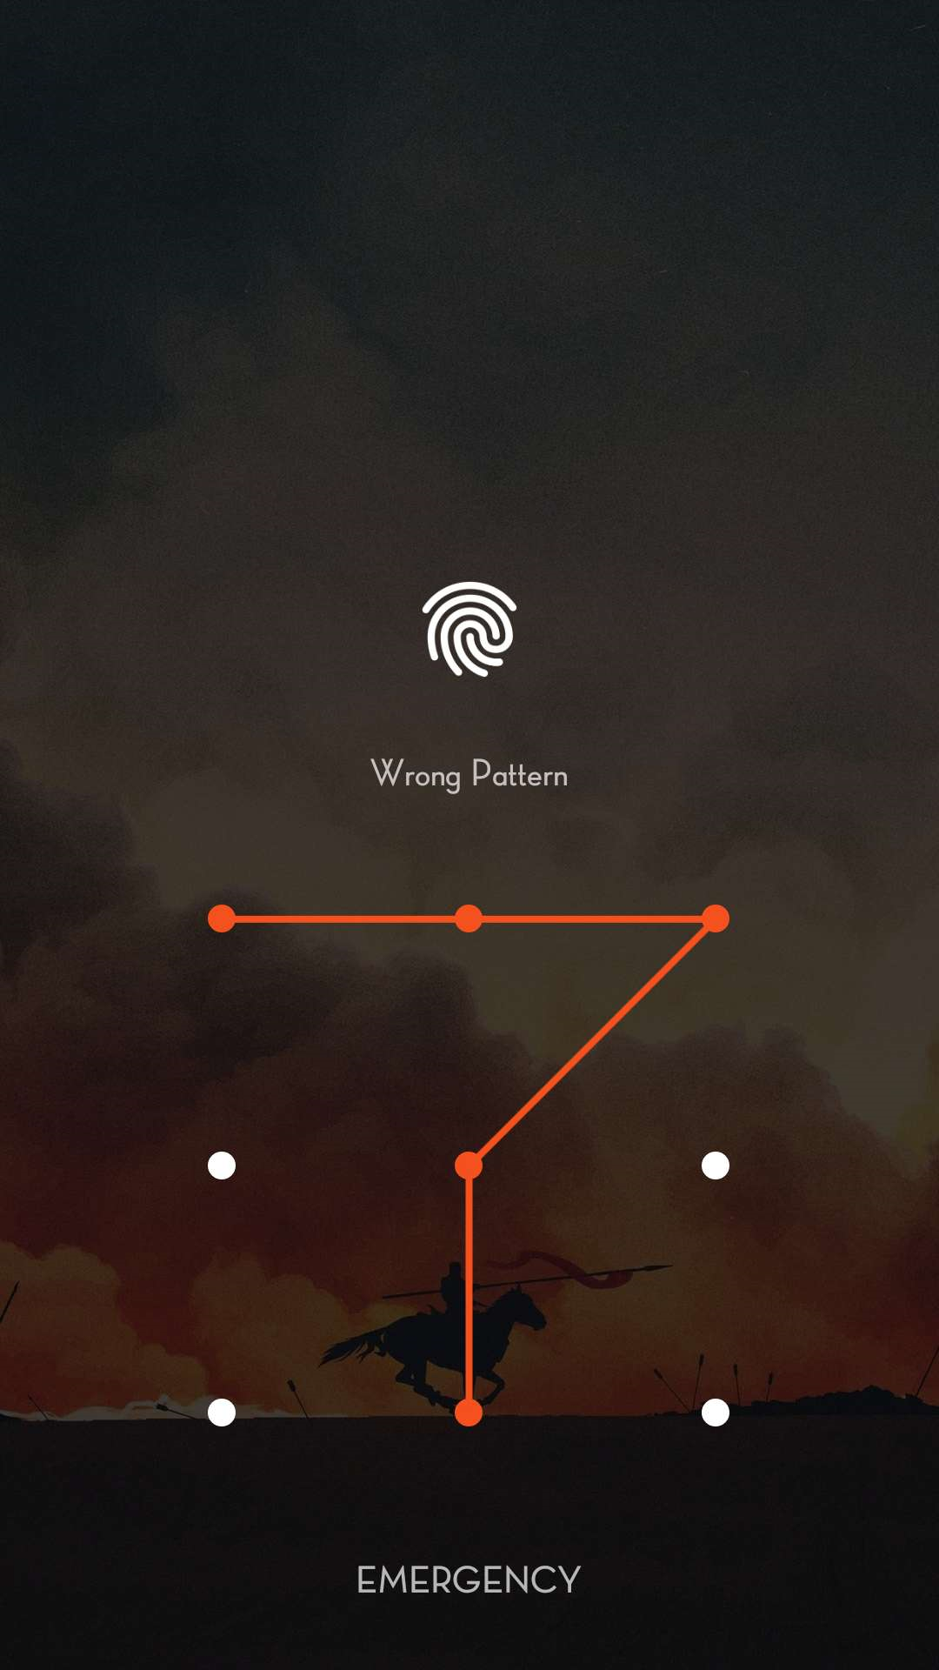
Motivations:
Android unlock pattern is one of the most common unlock methods in our daily life, so we want to know:
How secure exactly are these patterns?
Security ≈ Number of Valid Gestures

Slide 4
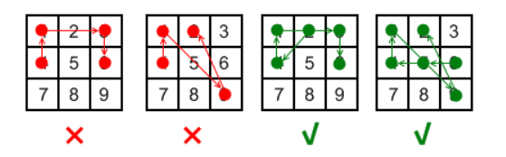
Valid Unlock Gesture:
Rules:
Gesture must be consecutive, keys must be distinct.
No jump through unselected key.
The order of keys used matters.

Slide 5
Algorithms
Brute Forth method
DFS method
BackTracking method
DP method
A Smarter Way

Slide 6
1
Brute Force
Permutation
Find valid ones
Use recursion method to get all permutations of possible gestures.
According to invalid permutations stored in hashmap, find the number of valid gestures from previous part.

Slide 7
BackTracking
2
Continue selecting an unused vertex until the length is satisfied.
Check if it is valid before adding it to gestures.
If it is not valid, the algorithm rejects the current vertex, backtracks and continues.
demo

Slide 8
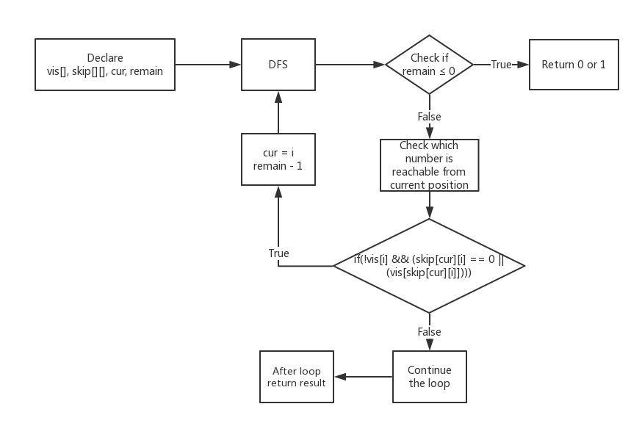
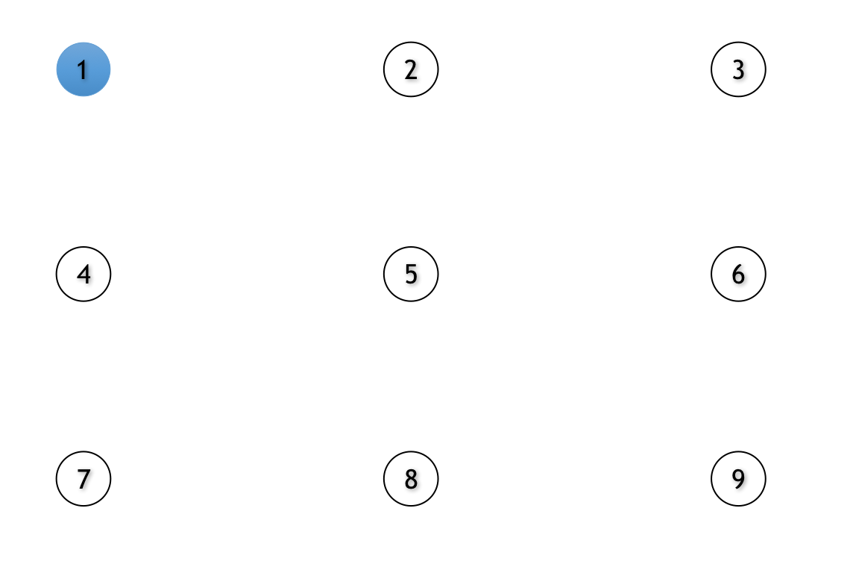
3
DFS Implementation
Basic Idea

Slide 9
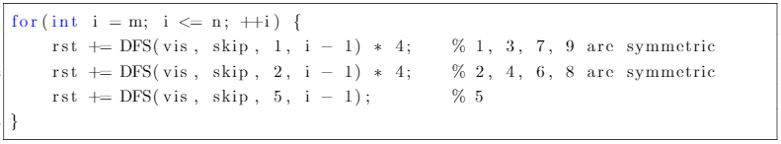
Optimization
Because of symmetry, 1, 3, 7, 9 and 2, 4, 6, 8 can be calculated in the same way.

Slide 10
4
A Smarter Way
isVisited :
Graphical relationship
Update “used” (9-bit bitmask) :
used2 = used | (1 << (i * 3 + j))
Judge if visited :
used2 > used
Space complexity is O(1)
Find middle node :
((i1+i2) % 2) ==1 || (j1+j2) % 2)==1)==0
If exists middle node :
used & (1 << (I / 2 * 3 + J / 2))!=0
Time complexity is O(9^n)
Demo
Notes:
a 9-bit bitmask ---isvisted[]
graphical relationship---middle node[]

Slide 11
Dynamic Programming
5
dp[len][state][endNode]
void calcDP(n)
Android pattern table
Pattern length [len]
End as [endNode]
Visited nodes [state] (9-bit bitmask)
nextState = (state | (1 << (i - 1)));
Set up start node :
“dp[1][1 << (i - 1)][i] = 1”
Traverse, find pattern with previous node :
“dp[len][state][endNode]!=0”
Find next valid node :
“skip[endNode][i] == 0 ||
((state & (1 << (skip[endNode][i]
- 1))) != 0)”
Update pattern table
Demo
Notes:
dp[len][state][endNode]:potential android patterns
search way:bfs 1 11 1001 update next start node
isvisited[]:9-bit bitmask state

Slide 12
Experiments
Intel Core i5-5257U with 8GB memory and 64 bit build Late 2015 MacBook Pro. The inversion of Java is 1.8.0_144-b01.

Slide 13
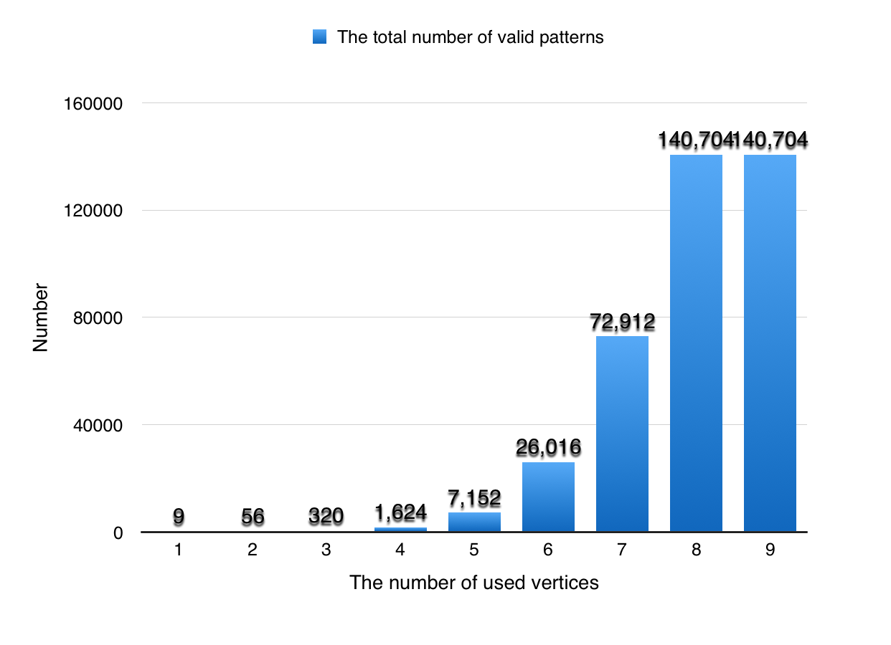
Results and Performance
Result
Security of gestures with 8, 9 vertices ≈ 5 digits PIN.
However, most people use 5 to 7 vertices, ≈ iPhone 4 digits PIN.

Slide 14
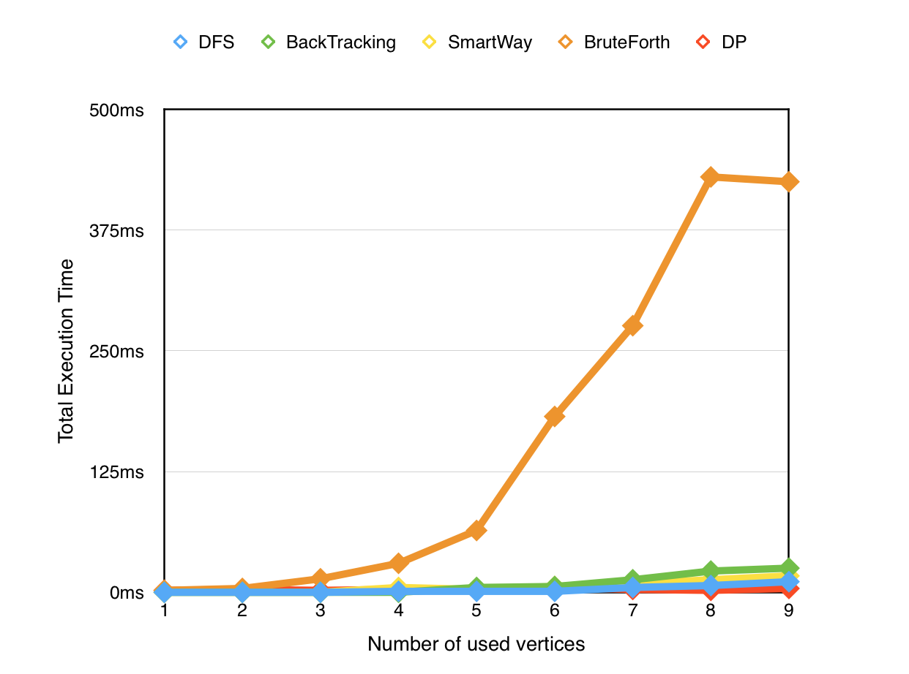
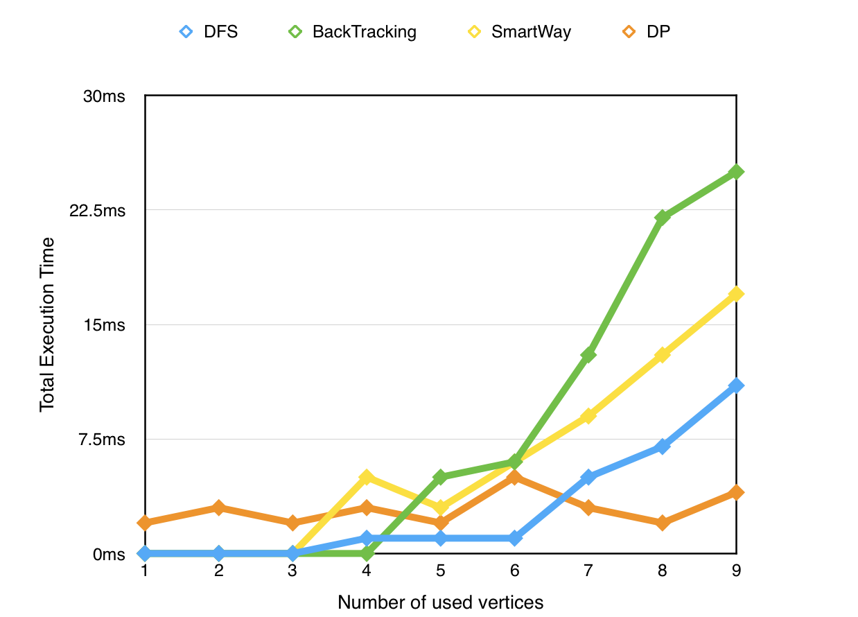
Performance

Slide 15
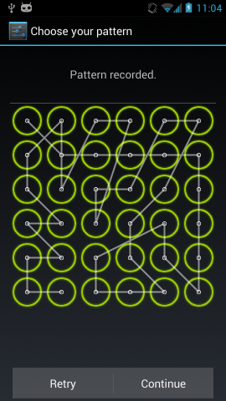
Future Work
In the future, we'd like to expand the size of pattern to 4*4, 5*5 and even more complicated.

Slide 16
Thanks!
Any questions?
You can find us at:
tw445@scarletmail.rutgers.edu
xt63@scarletmail.rutgers.edu
xl422@scarletmail.rutgers.edu

